Slide 1
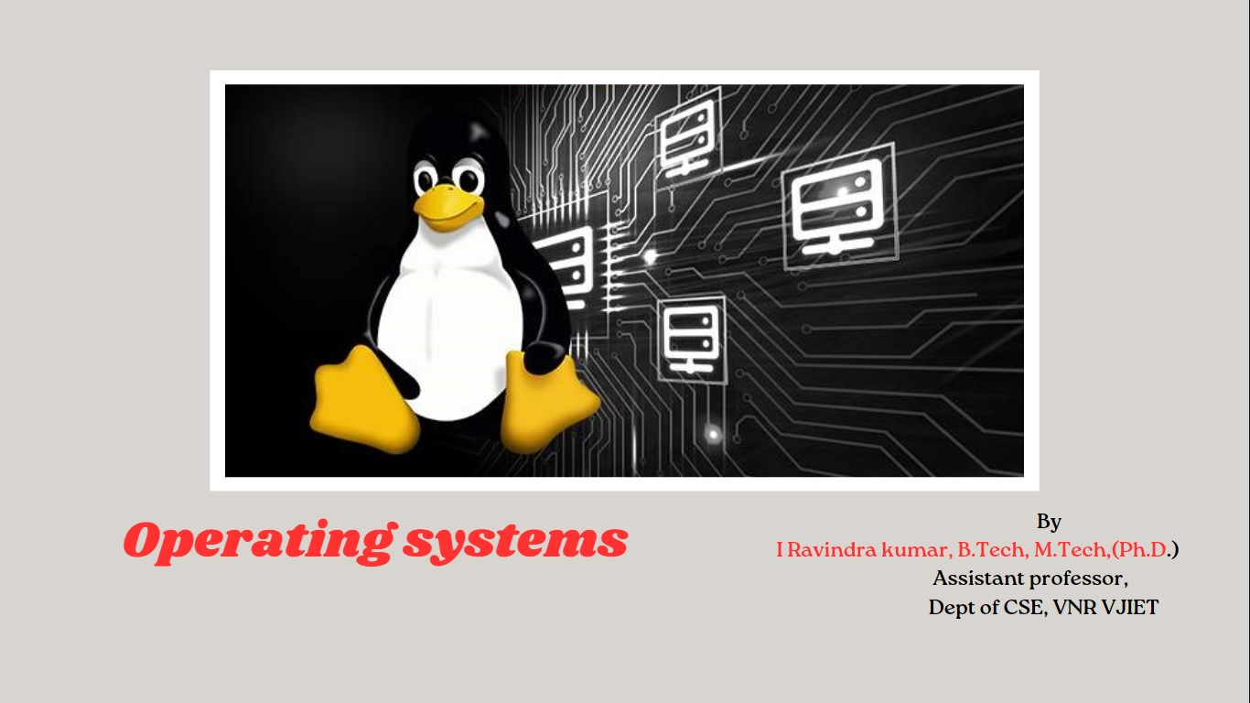
Operating system
By
I Ravindra kumar, B.Tech, M.Tech,(Ph.D.)
Assistant professor,
Dept of CSE, VNR VJIET

Slide 2
Interprocess Communication-
The transfer of data among different processes
There are two fundamentally different approaches in IPC:
  processes are residing on the same computer
  processes are residing on different computers
this chapter is focused on IPC on a single computer system, including four general approaches:
  Pipes
    A pipe is a serial communication device (i.e., the data is read in the order in which it was written),which allows a unidirectional communication.
    The data written to end is read back from the other end.
    two types of pipe
Named pipes(FIFOs).: allows for communication between unrelated processes
Unnamed pipes (Anonymous pipes):used only between related processes which can inherit the file handles (file descriptors)
  Shared memory
  Messages
  Sockets

Slide 3

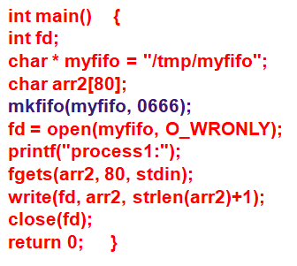
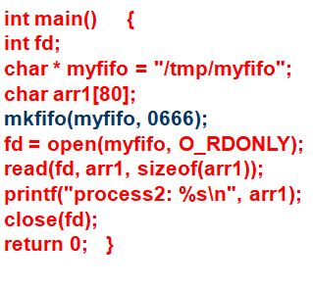
Named pipe:
FIFO creation: we can use either mknod or mkfifo commands.
  int mkfifo ( const char *pathname, mode_t mode );
  int mknod(const char *filename, mode_t mode|S_IFIFO,(dev_t) 0);
Accessing FIFO:using low-level I/O functions or C library I/O functions.

Slide 4
Unnamed pipe:
used to "pipe" two programs: standard output from one program is redirected to the pipe input (write handle),
while the standard input of the second program is redirected to from the pipe output (read handle).
Creating pipes:
#include<unistd.h>
int pipe(int file_descriptor[2]);
dup call is to open a new file descriptor, which will refer to the same file as an existing file descriptor
int dup2(int file_descriptor_1, int file_descriptor_2);

Slide 5
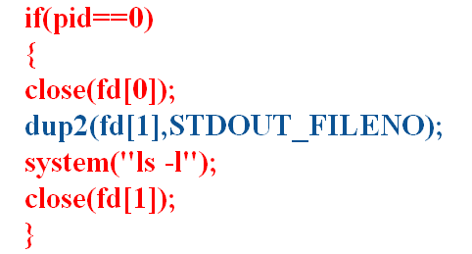
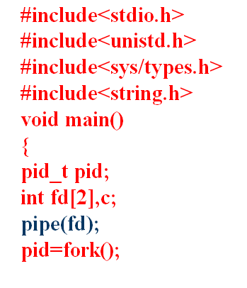
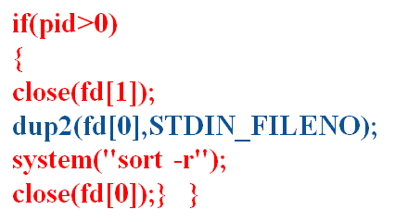

Slide 6
Shared Memory:
allows two unrelated processes to access the same logical memory.
It is thefastest form of IPC because all processes share the same piece of memory.
It also avoids copying data unnecessarily.
To use the shared memory,
  first of all one process should allocate the segment,
  and then each process desiring to access the segment should attach the segment.
  After accessing the segment, each process should detach it.
  It is also necessary to deallocate the segment without fail.
Shmget :Open and create a shared memory.
#include<sys/types.h> #include<sys/ipc.h> #include<sys/shm.h>
int shmget ( key_t key, int size, int flag );
Shmat : Attach a shared memory to a process virtual address space
void * shmat ( int shmid, void *addr, int flag );
Shmdt : Detach a shared memory from the process virtual address space.
shmdt ( void *addr );
Shmctl: Query or change control data of a shared memory or delete the memory.
int shmctl ( int shmid, int cmd, struct shmid_ds *buf );

Slide 7
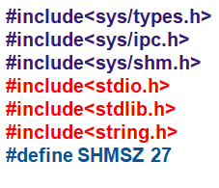
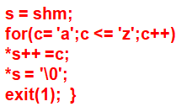
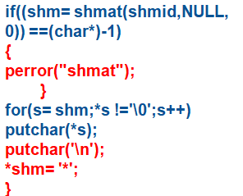
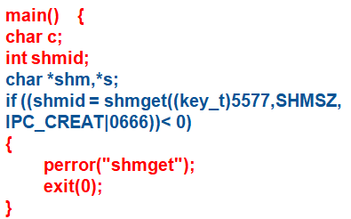
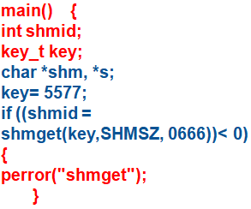
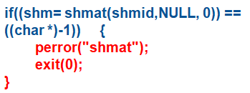

Slide 8
Message queue
struct msgbuf {
long mtype;
char mtext[1];
};
easy way of passing message between two process.
provides a way of sending a block of data from one process to another.
Advantage
  each block of data is considered to have a type,
  and a receiving process receives the blocks of data having different type values independently
You can create and access a message queue using the msgget() function. #include<sys/msg.h>
int msgget(key_t key,int msgflg);
The msgsnd() function allows to add a message to a message queue.
#include<sys/msg.h>
int msgsnd(int msqid,const void *msg_ptr ,size_t msg_sz,int msgflg);
control function of shared memory.
int msgctl(int msgid,int command, struct msqid_ds *buf);
The msgrcv() function allows to remove a message from a message queue
int msgrcv(int msgid, const void *msgp, size_t msgsz, long msgtype, int msgflg)

Slide 9
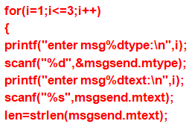
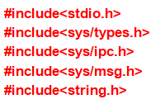
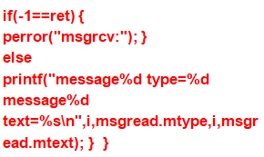

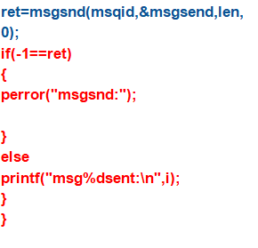
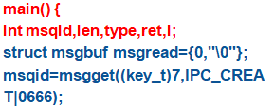
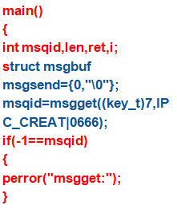
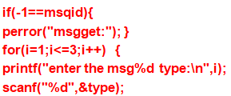


Slide 10



















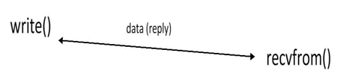




Connection oriented Connection less

Slide 11
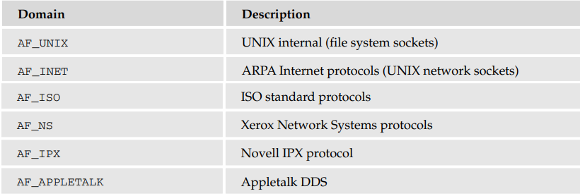
Sockets:
A socket is a communication mechanism that allows client/server systems to be developed either locally, on a single machine, or across networks.
The socket mechanism can implement multiple clients attached to a single server
Sockets are characterized by three attributes: domain, type, and protocols
The formats of the addresses vary depending on the domain, also known as the protocol family
Creating a Socket: int socket(int domain, int type, int protocol);
#include<sys/types/h> #include<sys/socket.h>

Slide 12
The socket parameter type specifies the communication characteristics to be used for the new socket.
SOCK_STREAM is a sequenced, reliable, connection-based two-way byte stream
SOCK_DGRAM is a datagram service, this type of communication is provided by UDP datagrams.
Socket Addresses:
Each socket domain requires its own address format.
For an AF_UNIX socket, the address is described by a structure, sockaddr_un, defined in the sys/un.h include file.
  struct sockaddr_un {
  sa_family_t sun_family; /* AF_UNIX */
  char sun_path[]; /* pathname */
  };
In the AF_INET domain, the address is specified using a structure called sockaddr_in, defined in netinet/in.h, which contains at least these members:
  struct sockaddr_in {
  short int sin_family; /* AF_INET */
  unsigned short int sin_port; /* Port number */
  struct in_addr sin_addr; /* Internet address */
  };
The IP address structure, in_addr, is defined as follows:
struct in_addr { unsigned long int s_addr; };

Slide 13
Naming a Socket:
To make a socket (as created by a call to socket) available for use by other processes, a server program needs to give the socket a name.
int bind(int socket, const struct sockaddr *address, size_t address_len);
Creating a Socket Queue:
To accept incoming connections on a socket, a server program must create a queue to store pending requests. It does this using the listen system call.
int listen(int socket, int backlog);
Accepting Connections:
Once a server program has created and named a socket, it can wait for connections to be made to the socket by using the accept system call.
int accept(int socket, struct sockaddr *address, size_t *address_len);
Requesting Connections
Client programs connect to servers by establishing a connection between an unnamed socket and the server listen socket. They do this by calling connect.
int connect(int socket, const struct sockaddr *address, size_t address_len);
Closing a Socket You can terminate a socket connection at the server and client by calling close

Slide 14
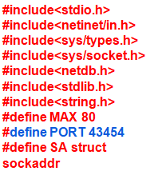
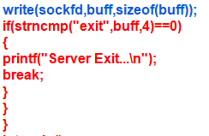
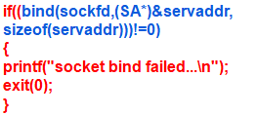
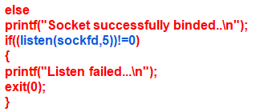
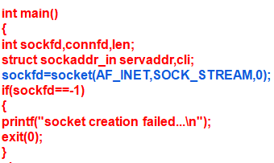
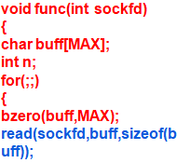
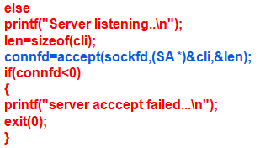
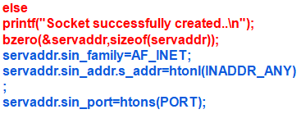
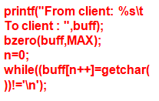


Slide 15
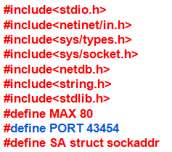
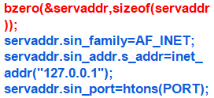

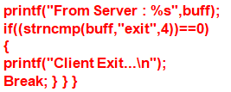
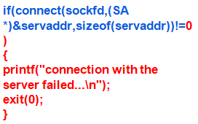
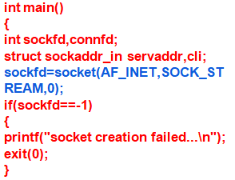
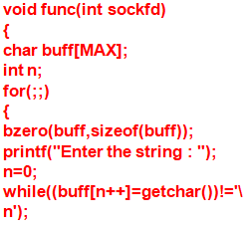
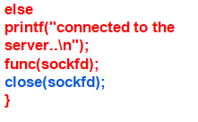


Slide 16
#include <sys/socket.h>
int socket(int domain, int type, int protocol);
int bind(int sockfd, const struct sockaddr *addr, socklen_t addrlen);
struct sockaddr { sa_family_t sa_family; char sa_data[14]; }
int listen(int sockfd, int backlog);
int connect(int sockfd, const struct sockaddr *addr, socklen_t addrlen);
int accept(int sockfd, struct sockaddr *_Nullable restrict addr, socklen_t *_Nullable restrict addrlen);
ssize_t read(int fd, void buf[.count], size_t count);
ssize_t write(int fd, const void buf[.count], size_t count);
int close(int fd);

Slide 17

Thank YOU

